Slide 1
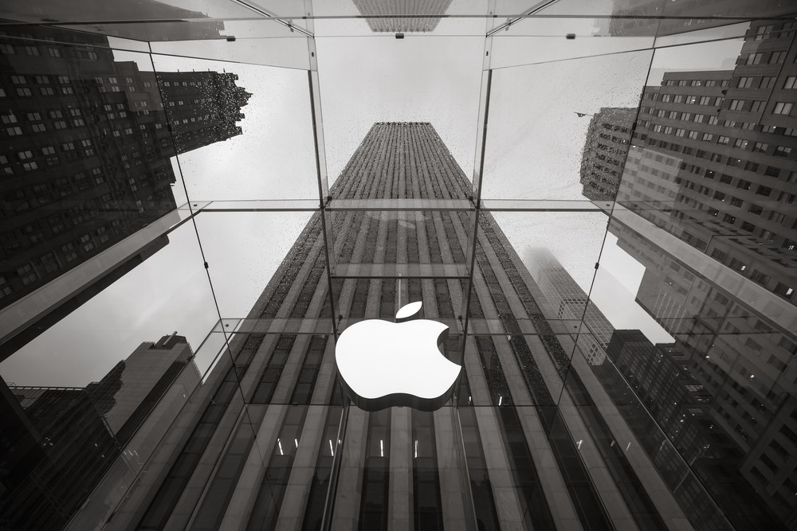
Apple Case Study
Name: Apple Inc.
Trading symbol: AAPL
Stock exchange: National Association of Securities Dealers Automated Quotations (NASDAQ)
No. shares of common stock outstanding: 15,441,881,000
Industry:Information Technology
Sector: Technology Hardware & Equipment
Country: United States
by Team 4
Credit Analysts : Shreya, Xinhao, Kevin

Slide 2
BACKGROUND
Page ‹#›
Designs, manufactures and market smartphones, personal computers, tablets, wearables and accessories, and sells a variety of related services.
The Company’s fiscal year is the 52- or 53-week period that ends on the last Saturday of September.
As of September 30, 2023, the Company had approximately 161,000 full-time equivalent employees.
As of October 20, 2023, there were 23,763 shareholders of record.
Products includes :
iPhone: Smartphones with iOS.
Mac: Personal computers with macOS.
iPad: Tablets with iPadOS.
Wearables: Smartwatches (Apple Watch Ultra 2, Series 9, SE), wireless headphones (AirPods, AirPods Pro, AirPods Max, Beats).
Home: Streaming/gaming (Apple TV), smart speakers (HomePod, HomePod mini).
Accessories: Apple-branded and third-party accessories.

Slide 3
BACKGROUND
Page ‹#›
Services includes :
Advertising: third-party licensing and Apple's advertising platforms.
AppleCare: Fee-based technical support and repair services under AppleCare brand
Cloud Services: Stores and synchronizes content across Apple devices and Windows PCs.
Digital Content: Platforms like App Store for apps and content downloads as well as subscription services
Payment Services: Apple Card (co-branded credit card) and Apple Pay (cashless payments).

Slide 4
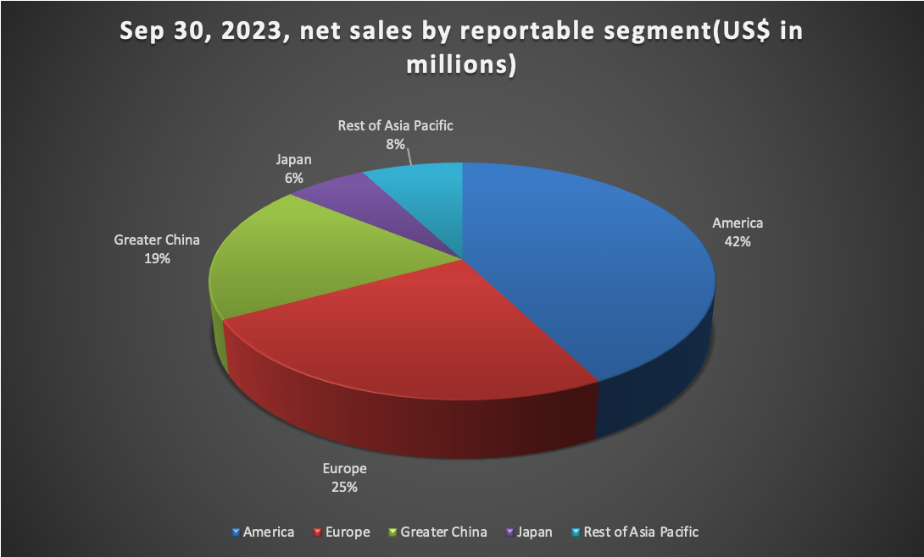
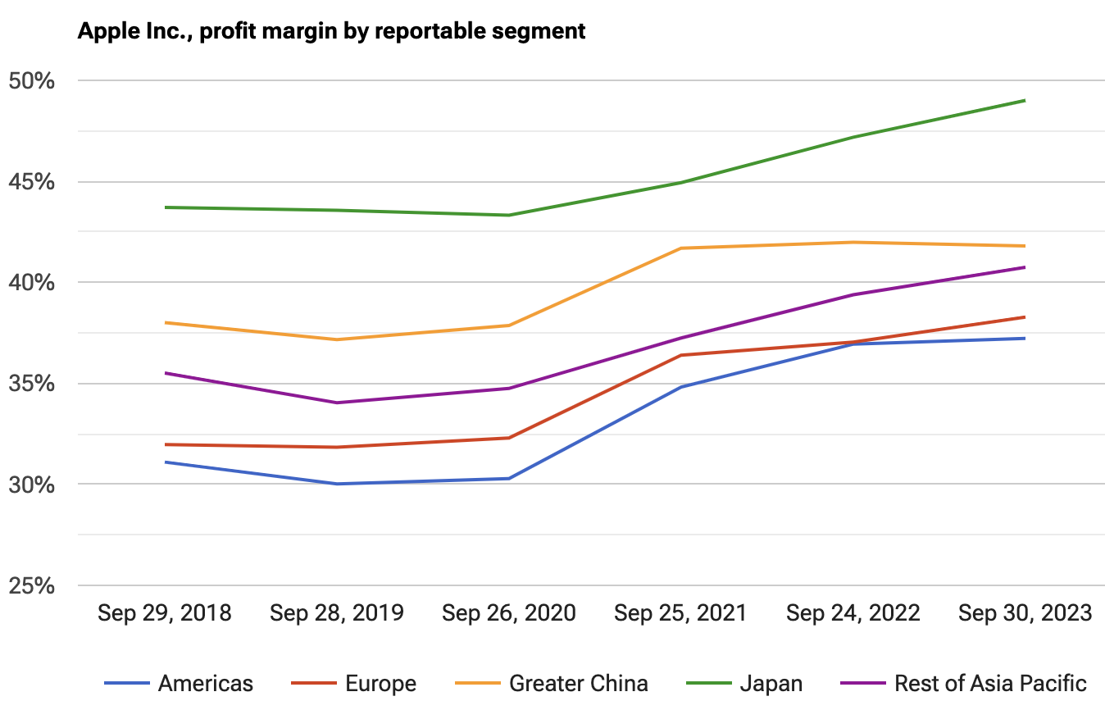
Geographic Segments
Page ‹#›
Americas: Encompasses both North and South America.
Europe: Includes European countries, the Middle East, and Africa.
Greater China: Covers China mainland, Hong Kong, and Taiwan.
Japan: Managed as a distinct segment.
Rest of Asia Pacific: Includes Australia and Asian countries not covered in other segments.

Slide 5
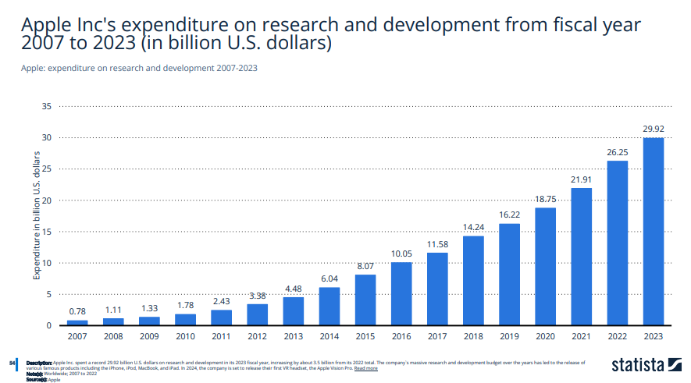
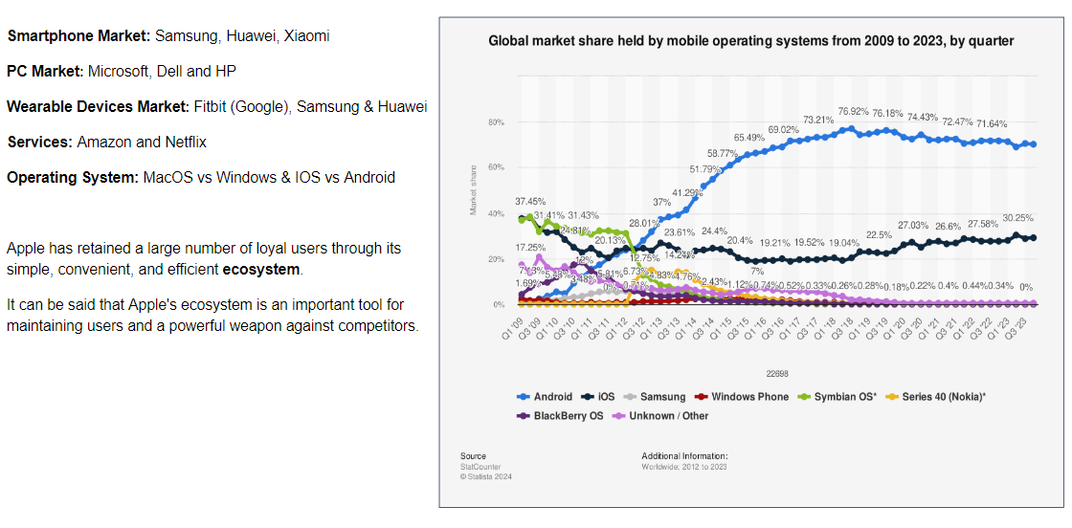
RISKS
Supply Chain Disruption Risks
Supplier distribution: Asia, Europe, and the Americas.
Production bases: China, India, Brazil, and Vietnam.
Problem:
Disruptions in the global supply chain, such as international health incidents and geopolitical economic issues, can affect the production and delivery of products, as well as impact the survival and development of suppliers.
Response Measures：
· Apple diversify its supply chain and spread its production bases globally.
· Provide financial support to key suppliers.
Intense Market Competition
Problem:
Increased competition can negatively impact market share and earnings. In the tech world, not staying ahead with innovation or falling behind competitors can lead to lower sales and affect profits.
Response Measures:
· Quality Assurance, Pricing Strategy, Marketing
· R&D Investment: Apple boosts its innovation by increasing research and development spending.
· Showcasing Strengths: Products like the M series chips and Apple Vision Pro highlight Apple's commitment to leading the market with innovative technologies.

Slide 6
RISKS
Global economic fluctuations & Currency fluctuations
Problem: Apple faces risks from changes in the global economy and currency values.
Response Measures:
· Utilizes various financial tools and strategies, like futures contracts and options, to hedge against these fluctuations.
Data Security and Privacy Protection
Problem: Data security and privacy are hot topics that can affect a company's reputation and user trust.
Response Measures:
· Apple's Commitment: Apple prioritizes the security and privacy of user data.
· Enhanced Security: Implements stronger encryption techniques and security protocols to protect user information.
· Global Compliance: Adheres to international data protection regulations to ensure user privacy is respected worldwide.
Intellectual property and legal regulations
Problem: Protecting intellectual property and complying with international legal standards are crucial for Apple.
Response Measures:
· Actively safeguards its patents, trademarks, and copyrights worldwide.
· Ensures compliance with laws and regulations in different countries and regions.

Slide 7
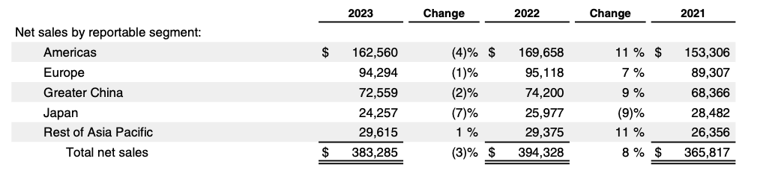
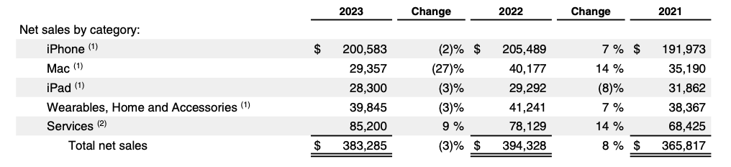
Financial Overview
Page ‹#›
2023 Financial Overview :
Total net sales: $383.3 billion.
Regional Sales: Americas, Europe, Greater China, and Japan saw decreases (4%, 1%, 2%, and 7% respectively), mainly from lower iPhone & Mac sales and currency impacts. Rest of Asia Pacific experienced a 1% increase, led by iPhone and Services.
Product Performance: iPhone sales slightly down by 2%, Mac declined sharply by 27%, and iPad decreased by 3%. Wearables and Accessories also fell by 3%. Services, however, grew by 9% across all areas.
Notes:
https://unsplash.com/photos/2ugtRrYMLLk

Slide 8
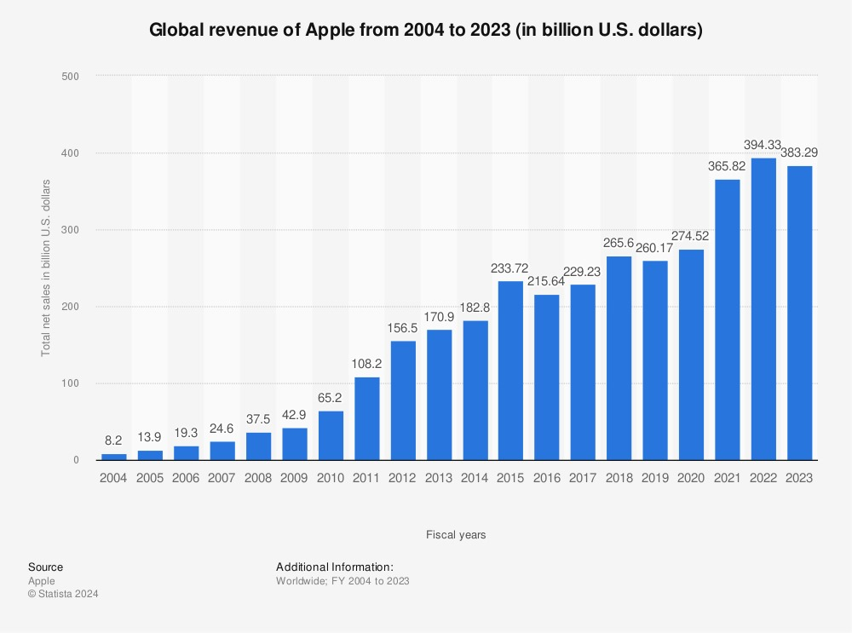
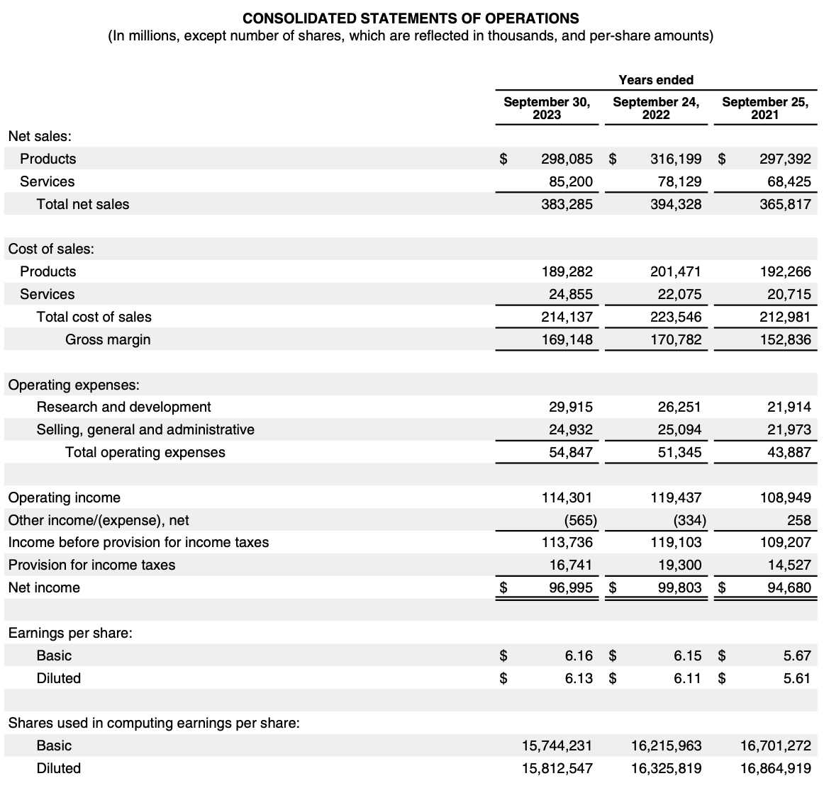
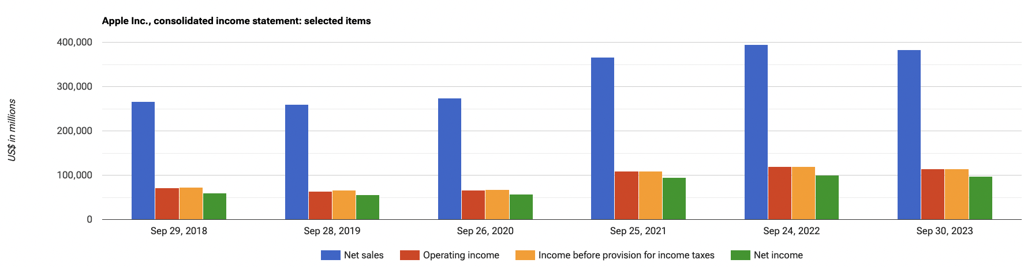
2023 Financial Overview :
Total net sales: $383.3 billion.
Net sales increased from 2021 to 2022 but then slightly decreased from 2022 to 2023.
operating income increased from 2021 to 2022 but then slightly decreased from 2022 to 2023.
Income before provision for income taxes increased from 2021 to 2022 but then slightly decreased from 2022 to 2023 not reaching 2021 level.
Net income: $97.0 billion which increased from 2021 to 2022 but then slightly decreased from 2022 to 2023 not reaching 2021 level..
Page ‹#›

Slide 9
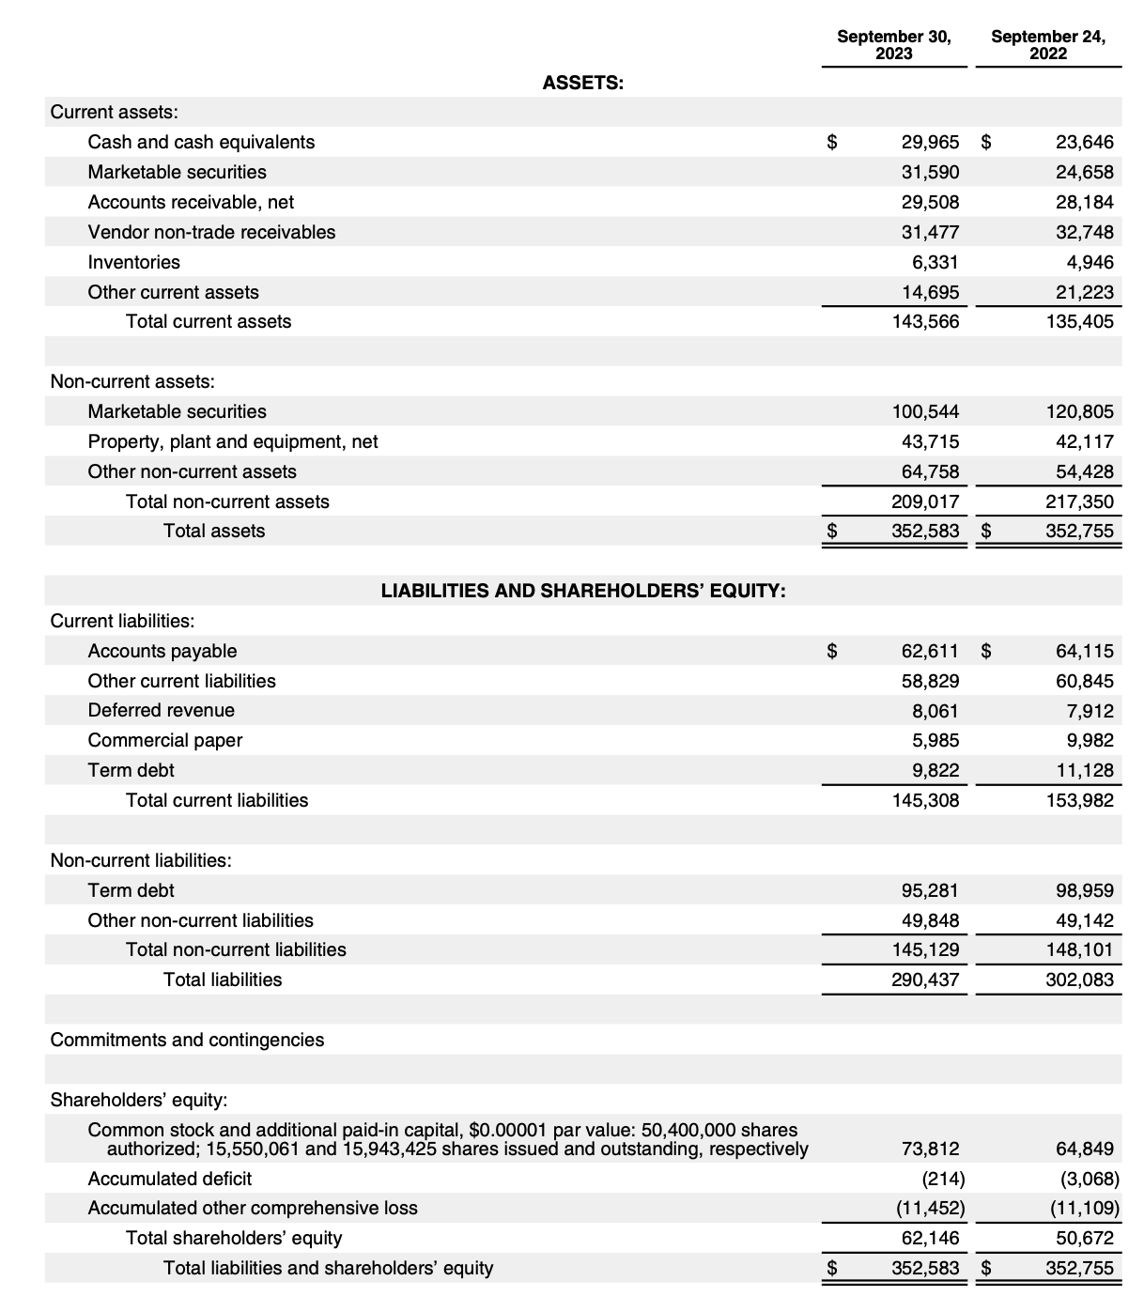
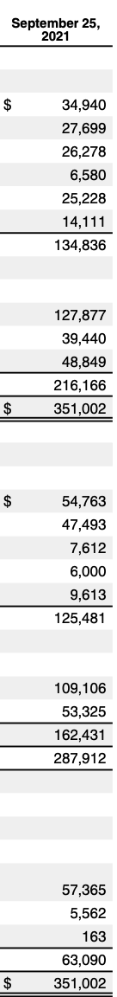
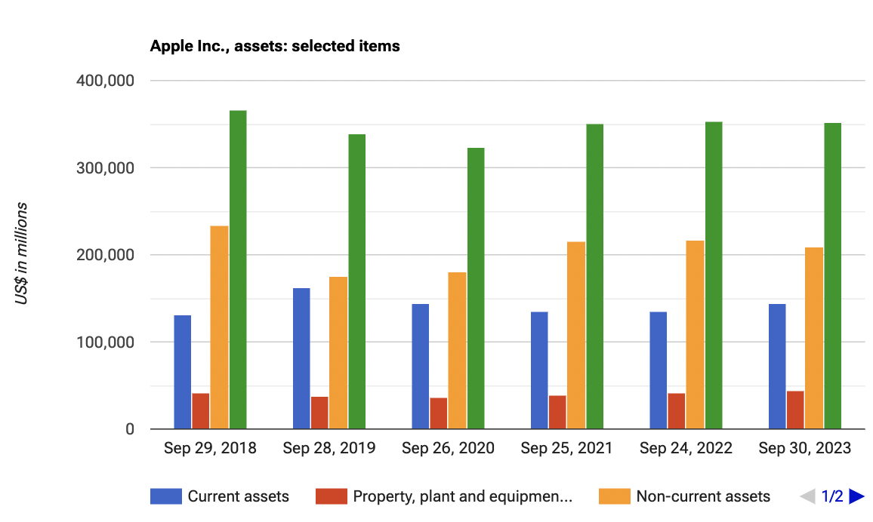
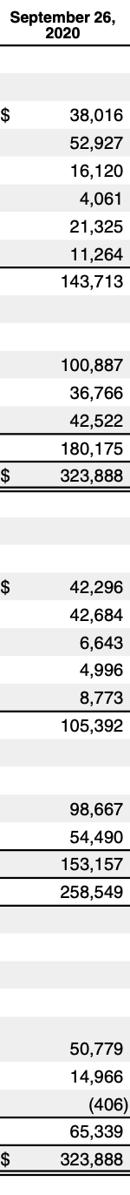

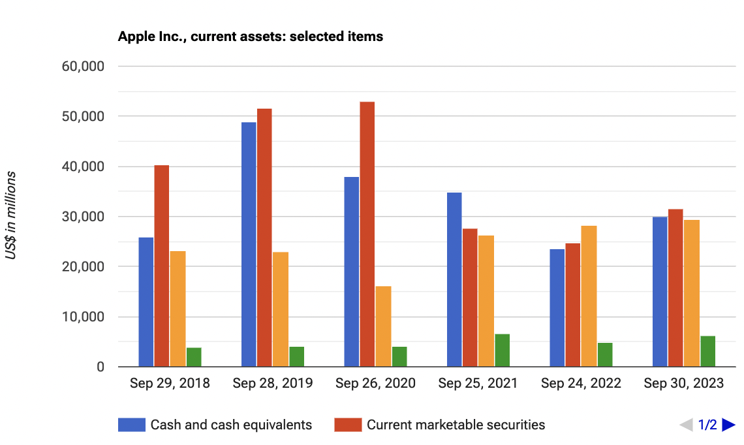

Balance Sheet

Slide 10
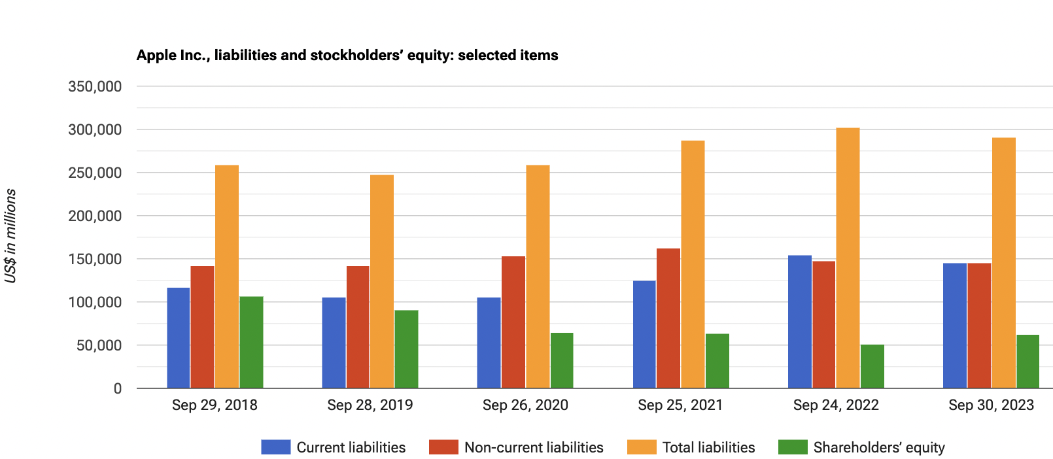
Balance Sheet

Slide 11
Draw from Balance sheet
Page ‹#›
Asset Growth: Expansion seen as total assets increase from $323.888 billion in 2020 to $352.583 billion in 2023.
Liquidity: High liquidity with $29.965 billion in cash equivalents in 2023, crucial for operational needs.
Diversification of Assets: Current assets diversification, including $100.544 billion in marketable securities in 2023, enhances liquidity.
Property, Plant, and Equipment: Steady increase in these assets indicates ongoing investment in productive capacity.
Liabilities Management: Despite increased total liabilities, current liabilities remain stable, indicating prudent short-term borrowing.
Long-term Debt Management: Increased term debt managed against asset and equity growth and cash flow capabilities.
Shareholders' Equity: Equity grows to $62.146 billion in 2023, showing increased company value despite deficits.
Accumulated Other Comprehensive Loss: Includes unrealized losses, not impacting liquidity or cash flow.

Slide 12
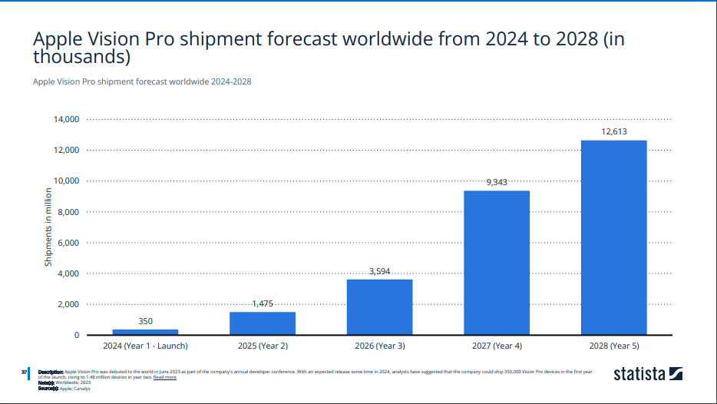
2024 Plans
Page ‹#›
Apple Vision Pro
Revenue Growth
Return on R&D Investment
Long-term Market Positioning
Hardware updates：
Based on Apple’s update cycle, new version of the iPhone, ipad, Mac, and Apple Watch are expected, likely including new designs and technological upgrades.
Software Updates:
Release new versions of operating systems, such as IOS, IpadOS, macOS, and watchOS, introducing new features and improving user experience.
Technological Innovations:
Continue innovation in area such as chip technology, artificial intelligence, augmented reality, and health technology.
Service Expansion:
Further expand Apple’s services business, including Apple music, Apple TV plus, iCloud, etc.

Slide 13
Ratio Analysis and Projections
Page ‹#›
Ratio Analysis |  | 2022 | 2023 | 2024 | 2025 | 2026
Return Ratios | Return on Assets | 28.29% | 27.5% | 29.42% | 32.36% | 37.53%
 | Return on Investments | 66.7% | 61.61% | 65.91% | 68.49% | 72.07%
Liquidity Ratios | Current Ratio | 8.794% | 9.88% | 10.56% | 11.62% | 10.7%
 | Debt/Equity Ratio | 2.37% | 1.78% | 2.21% | 3.16% | 2.3%
 | Days sales in receivables | 56.4 days | 58.07 days | 61.06 days | 59.7 days | 60.4 days
Efficiency Ratio | Gross Margin | 43.3% | 44.13% | 45.6% | 46.8% | 48.3%
 | Operating margin | 30.28% | 29.82% | 31.36% | 32.48% | 31.24%

Slide 14

CONCLUSION
Page ‹#›
The conclusion is positive :
Positive Financial Review: Credit analysis of Apple Inc. reveals a strong financial position.
Key Financial Strengths: Highlighted by robust liquidity, solid asset foundation, and healthy equity.
Operational Stability: Consistent cash flow and strategic debt management underscore operational efficiency.
Profitability and Risk Management: Despite fluctuations, a trend of profitability and low credit risk due to prudent management and significant reserves.
Financial Flexibility: Ability to meet short-term obligations, fuel growth, and enhance shareholder value through dividends and buybacks.
Strategic Positioning: Financial statements reflect a company well-positioned for future growth, underpinned by stability and strategic planning.
Notes:
https://unsplash.com/photos/2ugtRrYMLLk

Slide 15

THANK YOU

Slide 16
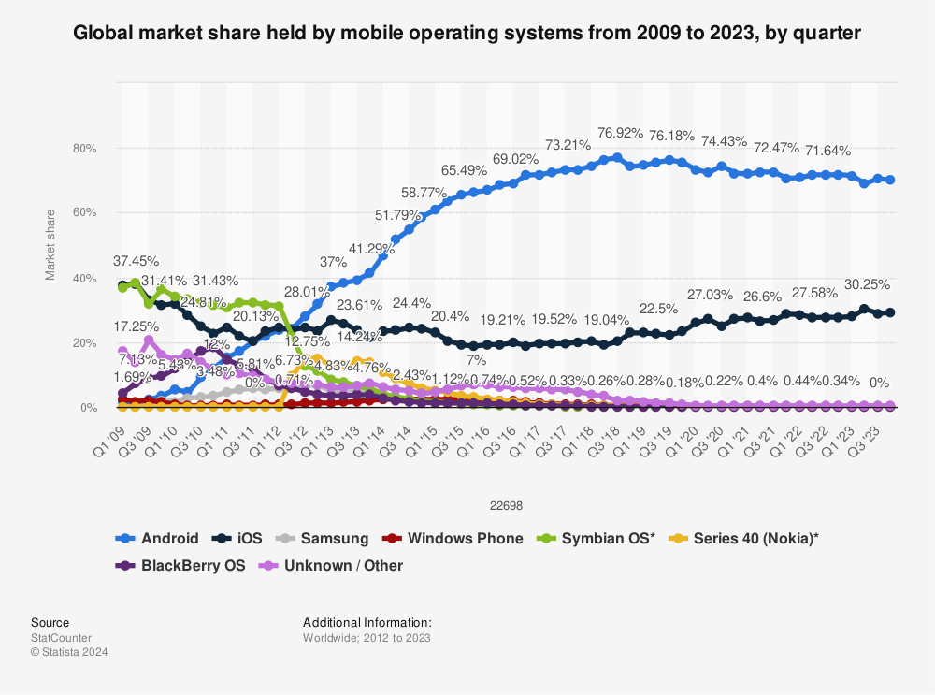
COMPETITION
Smartphone Market: Samsung, Huawei, Xiaomi
PC Market: Microsoft, Dell and HP
Wearable Devices Market: Fitbit (Google), Samsung & Huawei
Services: Amazon and Netflix
Operating System: MacOS vs Windows & IOS vs Android
Apple has retained a large number of loyal users through its simple, convenient, and efficient ecosystem.
It can be said that Apple's ecosystem is an important tool for maintaining users and a powerful weapon against competitors.

Slide 17

Contents
Background
Geographic segments
Fiscal year Highlights
CHAPTER THREE
CHAPTER FOUR
Research Methodology
Anticipated Findings
REFERENCES
ABSTRACT

Slide 18
RISKS
Page ‹#›
Macroeconomic and Industry Risks
Business Risks
Legal and Regulatory compliance Risks
Apple must continually innovate and manage product transitions to remain competitive.
Dependence on component and product manufacturing from outsourcing partners, mainly located outside the U.S., can lead to risks related to quality control, supply chain disruptions, and reduced operational control.
Apple is subject to a multitude of legal proceedings and government investigations, which, if resolved unfavorably, could materially affect its operations and finances.
Changes in laws and regulations worldwide, particularly regarding antitrust, privacy, and digital platforms, can result in increased costs, limit product offerings, and necessitate significant operational changes.
Global Economic Sensitivity: Apple's performance can be affected by economic downturns, inflation, and currency changes, impacting consumer demand.
Supply Chain Vulnerability : International operations and complex supply chains expose Apple to risks from political events, trade disputes, and global disruptions.

Slide 19
RISKS
Page ‹#›
Financial Risks
General Risks
The company's stock price is subject to volatility and may be affected by broader market trends, the company's performance, and investor perceptions.
Quarterly financial results are expected to fluctuate due to various factors including product mix, currency exchange rates, and competitive pressures.
Apple's investment portfolio is susceptible to market changes, and trade receivables carry credit risk, potentially heightened in adverse economic conditions.
Notes:
These risk factors suggest that while Apple is a robust company with a strong market position, it faces challenges typical of large multinational corporations, including economic conditions, business execution, legal and regulatory environments, financial market changes, and stock market perceptions. Each of these areas presents potential hurdles that Apple must navigate to maintain its business success and shareholder value.

